Slide 1
Capstone Engagement
Assessment, Analysis, and Hardening of a Vulnerable System
Elise Vanaman

Slide 2
Table of Contents
This document contains the following sections:
01
Network Topology
02
Red Team: Security Assessment
03
Blue Team: Log Analysis and Attack Characterization
Hardening: Proposed Alarms and Mitigation Strategies
04

Slide 3
Network Topology
‹#›

Slide 4
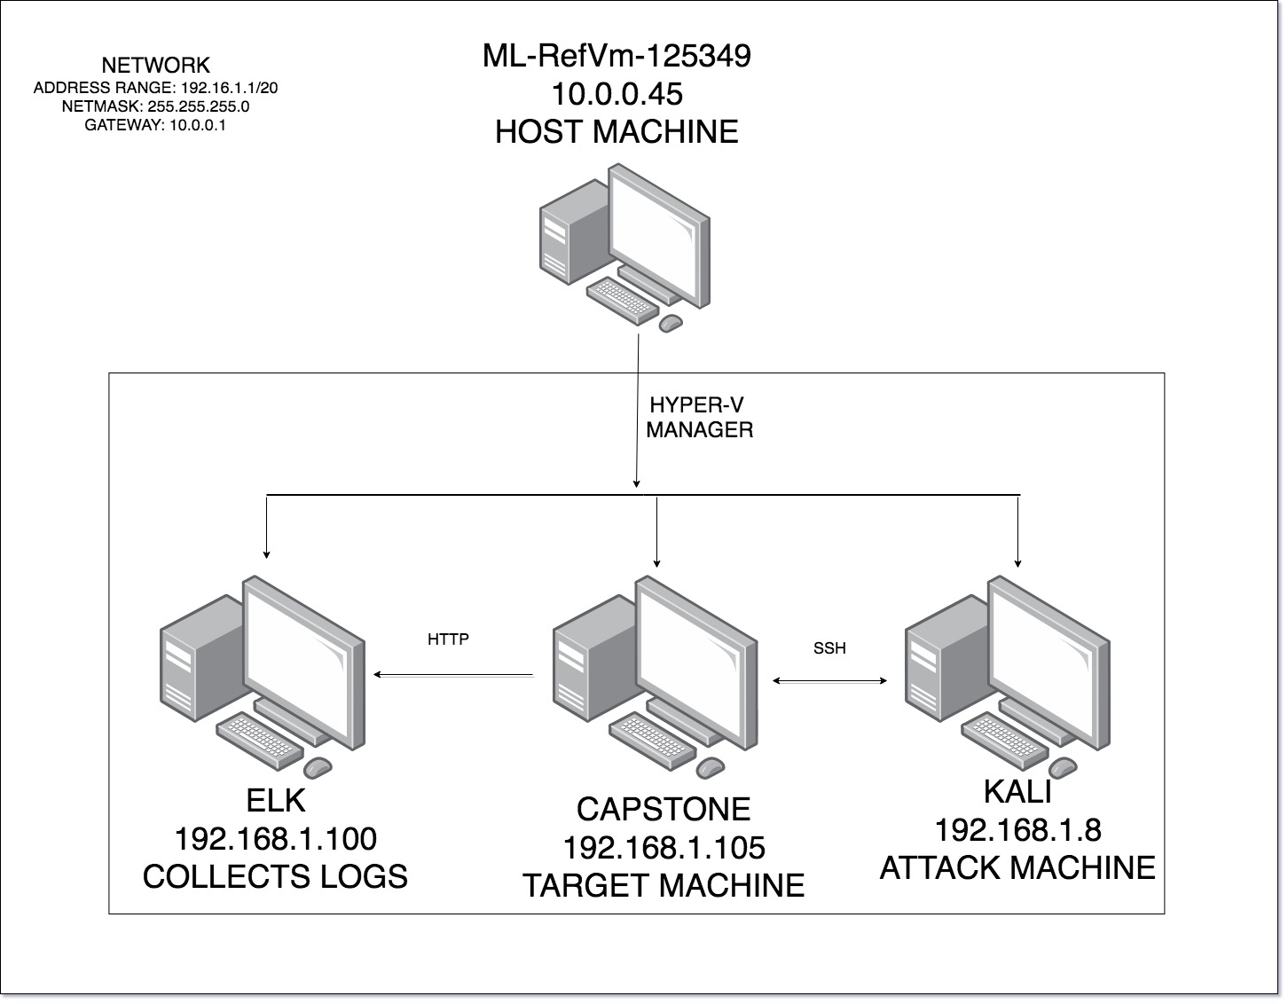
Network Topology
Network
Address Range: 192.168.1.1/20
Netmask: 255.255.255.0
Gateway: 10.0.0.1
Machines
IPv4: 192.168.1.8
OS: Kali GNU/Linux Rolling
Hostname: Kali
IPv4: 192.168.1.100
OS: Ubuntu 18.04.3 LTS
Hostname: ELK
IPv4: 192.168.1.105
OS: Ubuntu 18.04.1 LTS
Hostname: Capstone
IPv4: 10.0.0.45
OS: Microsoft Windows 10 Pro
Hostname: ML-RefVm-125349

Slide 5

Red Team
Security Assessment
‹#›

Slide 6
Recon: Describing the Target
Nmap identified the following hosts on the network:
Hostname | IP Address | Role on Network
ELK | 192.168.1.100 | All logs; including attack logs and metrics, are sent to the ELK server from the Capstone machine.
Kali | 192.168.1.8 | The attack machine that will search for and exploit any vulnerability on the Capstone machine.
Capstone | 192.168.1.100 | The vulnerable virtual machine that is exploited and attacked by the Kali machine.
Microsoft Windows 10 Pro | 10.0.0.45 | Host of VM and Hyper-V and also the default gateway.

Slide 7
Vulnerability Assessment
The assessment uncovered the following critical vulnerabilities in the target:
Vulnerability | Description | Impact
Security Misconfiguration | Attackers will attempt to exploit unpatched flaws or access unprotected files and directories to gain unauthorized access to the system. | This allowed the attackers to not only gain access to the companies private database, but also allowed to attacker to implant a php file that was used to exploit the target.
Broken Authentication | Attackers have access to millions of valid username and password combinations for automated brute force attacks. These can be exploited to gain access to systems. | Attacker was able to gain access to the database and found usernames and passwords that were easily exploited with a brute force attack.
Sensitive Data Exposure | Attackers will steal keys or clear text data off of the server. This information will be used to infiltrate the system. | Attacker was able to brute force data found in a secret file and used it to infiltrate the whole system.

Slide 8
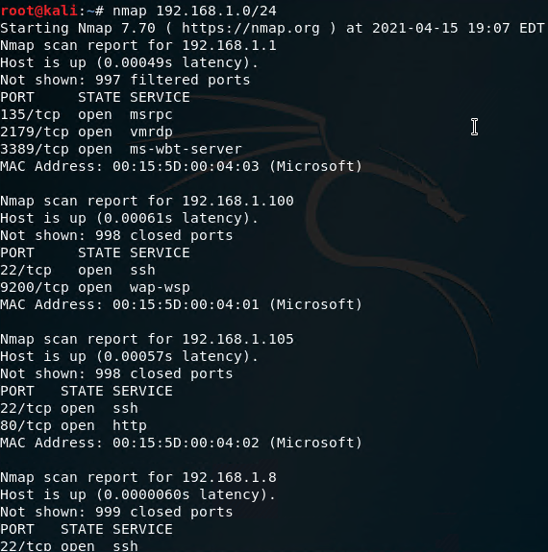
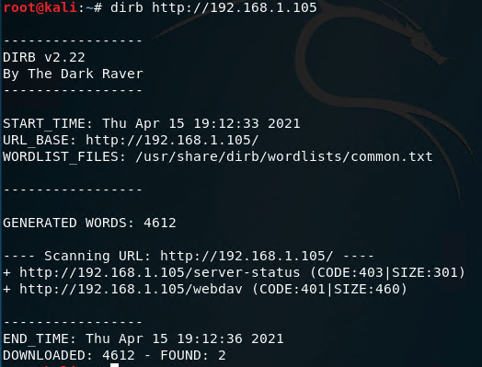
Exploitation: Security Misconfiguration
Tools & Processes
~The attacker used NMAP to locate the IP address.
~DIRB was used to isolate the websites that the IP address was connected to.
~By searching the IP address through a webserver the attacker found the companies personal files.
~Personal files were unencrypted and revealed information about a secret folder and user passwords.
Achievements
This exploit allowed the attacker to gain access to the companies database. Unencrypted files were located and lead to gaining access to the internal server.

Slide 9
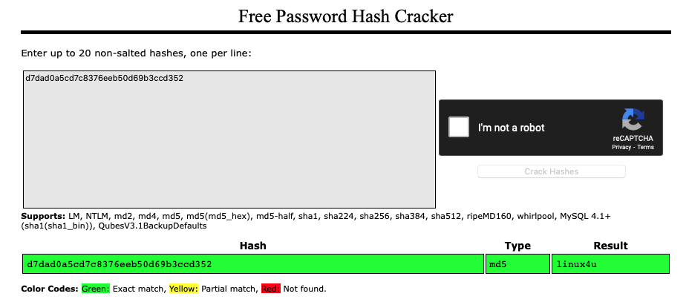
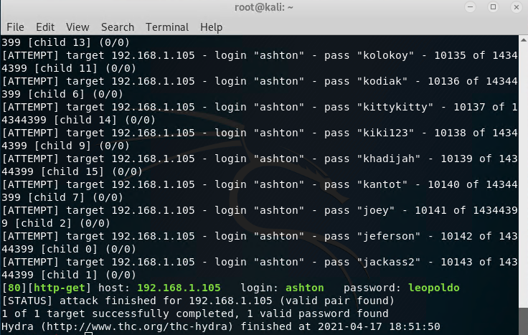
Exploitation: Broken Authentication
Tools & Processes
Tools used to conduct this type of exploit were Hydra and crackstation.net which were both used to exploit passwords.
Achievements
This exploit helped the attacker gain access to the secret_file, which then lead to access to the server.

Slide 10
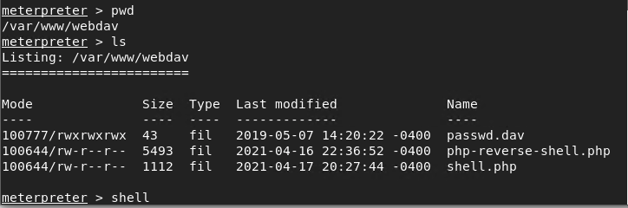
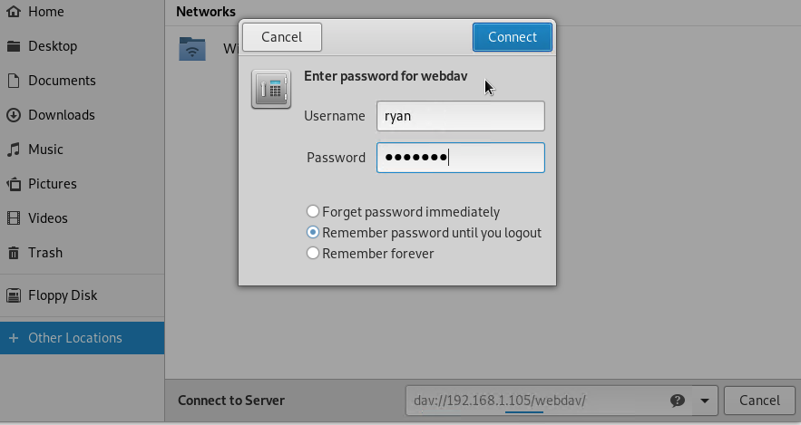
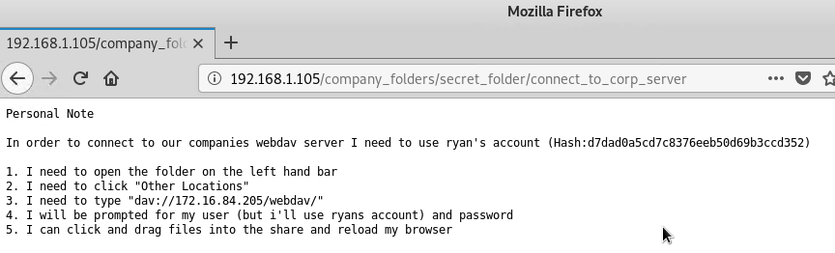
Exploitation: Sensitive Data Exposure
Achievements
This lead to the attacker gaining access to the company's server.
Tools & Processes
~Attacker used msfconsole to generate custom reverse-shell.
~The attacker used the information found to connect to the server and upload the malicious file.
~The attacker was then able to Shell into the server and access all files.

Slide 11

Blue Team
Log Analysis and Attack Characterization
‹#›

Slide 12

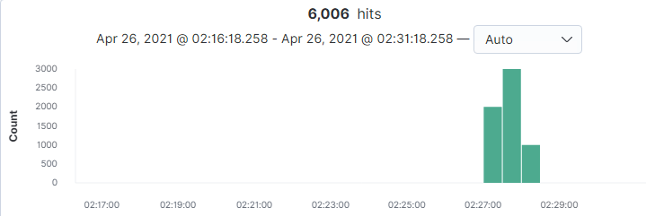
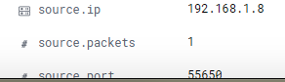
Analysis: Identifying the Port Scan
What time did the port scan occur? 0227
How many packets were sent, and from which IP? 6,006 Packets Sent from 192.168.1.8
What indicates that this was a port scan? Source port and source IP are all the same, destination port is different among all packets

Slide 13


Analysis: Finding the Request for the Hidden Directory
What time did the request occur? How many requests were made?
0304 and 7 request were made.
Which files were requested? What did they contain? Secret_files was requested and opened up instructions to another account.

Slide 14
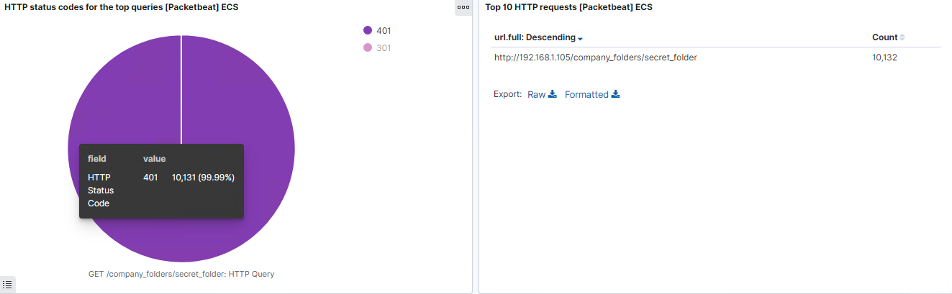
Analysis: Uncovering the Brute Force Attack
How many requests were made in the attack? 10,132
How many requests had been made before the attacker discovered the password? 10,131
[Insert Here]
Include a screenshot of Kibana logs depicting the brute force attack.

Slide 15
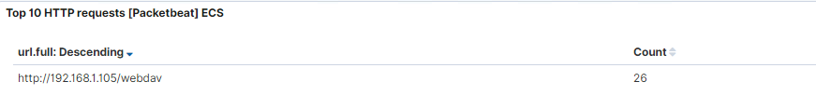
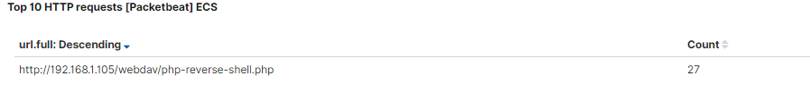
Analysis: Finding the WebDAV Connection
How many requests were made to this directory? 26
Which files were requested? php-reverse-shell.php

Slide 16
Blue Team
Proposed Alarms and Mitigation Strategies
‹#›

Slide 17
Mitigation: Blocking the Port Scan
What kind of alarm can be set to detect future port scans?
~An alert that notifies when there is an uptick in network traffic.
What threshold would you set to activate this alarm?
~It would depend on normal traffic, setting a threshold above that would help.
~Set a limit on specific IP addresses
What configurations can be set on the host to mitigate port scans?
~Block all unused or unnecessary ports.
~Ensure firewall is set up properly.

Slide 18
Mitigation: Finding the Request for the Hidden Directory
What kind of alarm can be set to detect future unauthorized access?
~An alert that detects any http-get requests from unknown IP addresses preventing outsiders from accessing the secret_folder.
What threshold would you set to activate this alarm?
~1 - any unknown IP address should be flagged
What configuration can be set on the host to block unwanted access?
~Create admin restrictions
~Encrypt database information
~Mandate strong, secure passwords

Slide 19
Mitigation: Preventing Brute Force Attacks
What kind of alarm can be set to detect future brute force attacks?
~An alert that send a notification when there are unsuccessful login attempts made within a certain time period.
What threshold would you set to activate this alarm?
~Setting a threshold of 10 attempts in a 15 min period then 10 mins until more attempts can be made.
What configuration can be set on the host to block brute force attacks?
~Enforce password requirements
~Use an IPS such as Fail2ban and HeatShield to protect the servers

Slide 20
Mitigation: Detecting the WebDAV Connection
What kind of alarm can be set to detect future access to this directory?
~An alert when there is an unknown IP connection to the internal server would help prevent this.
What threshold would you set to activate this alarm?
~Threshold of 1 should be set.
What configuration can be set on the host to control access?
~Setting proper RBAC privileges.
~Enforcing secure passwords.
~Blocking unused and unnecessary ports.

Slide 21
Mitigation: Identifying Reverse Shell Uploads
What kind of alarm can be set to detect future file uploads?
~An alert that will notify of any extension type not previously allowed (like .php)
~Alert set to notify when an certain upload size is reached.
~Alert when someone other than authorized personnel upload a file.
What threshold would you set to activate this alarm?
~1 - when any of the alerts occur once there should be an alert.
What configuration can be set on the host to block file uploads?
~Block any unused and unneeded ports.
~Ensure the firewall is properly configured and regularly audited.
~Secure remote access points.
~Have Filebeat enabled and properly configured.

